Slide 1


Project Presentation (KCS 753) (Neural Style Transfer)
KIET Group of Institutions, Ghaziabad
(An ISO – 9001: 2008 Certified & ‘A+’ Grade accredited Institution by NAAC)
Guide Name: Mr. Akash Goel
Project Members Name with Roll Number & Section
1.Palak Singh (2000290120103-B)
2.Ragini Rani (2000290120121-B)
3. Kalash Jain (2000290120080-B)

Slide 2
Problem Statement
The problem we wanted to solve in this project was how to improve the process of transferring the artistic style of one image to the content of another image using neural networks while maintaining the integrity of the content and achieve high quality results.
In other words, the central challenge to be addressed is how to make the neural type conversion process more efficient, productive and user-friendly, ensuring that it produces images that the tone is visually appealing while preserving the important elements of the original content.

Slide 3
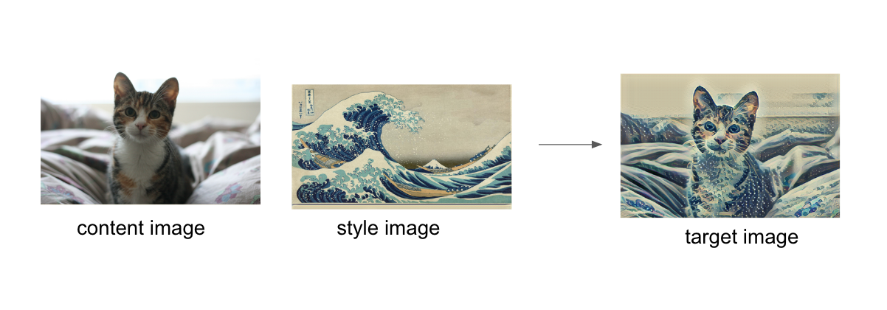
Style transfer

Slide 4
Objectives
Content Preservation: Ensure that the generated images retain the meaningful content and recognizable objects from the original input images.
Style Replication: Replicate the distinctive artistic styles, including textures, colors, and patterns, from reference images to create visually appealing and stylistically consistent output.

Slide 5
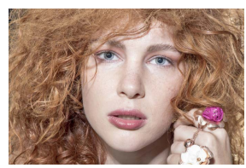
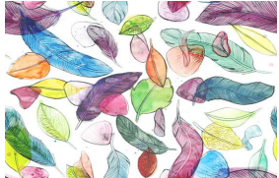
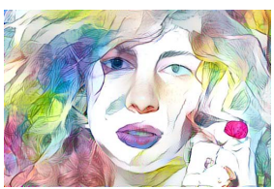
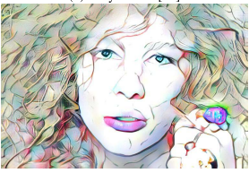
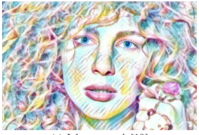
Multiple Style transfer:-
+
Content Image
Style Image
Output Image 1
Output Image 2
Output Image 3

Slide 6
Technology Used
Front end
Backend
Matplotlib
Pytorch
Tensorflow
Numpy
PIL(Python Imaging Library)

Slide 7
Literature Survey
Paper title - Neural Style Palette: a multimodal and interactive style
transfer from a single style image
Author name - John Jethro Virtusio, Jose Jaena Marie Ople, Daniel
Stanley Tan,M.Tanveer,Neeraj Kumar,and Kai-Lung Hua
Year of publishing - 2021
Followed by Summary of papers. -

Slide 8
The article discusses limitations in existing neural style transfer methods, which often produce only one stylized image from a single style input, offering limited variety and control to users. In response, the article introduces a method called Neural Type Palette (NSP). NSP is an interactive approach that generates multiple stylized images from a single style source, allowing users to influence the stylization process creatively.
NSP employs the concept of anchor styles, which act as visual guides for users. These anchor styles capture various attributes of the input image, each with a unique style. Users can blend these anchor styles to achieve their desired artistic results, offering diverse choices.
To maintain visual fidelity to the original style, NSP uses two new losses: a loss of separation to encourage distinct substructures in the stylized images and a loss of unity to ensure that the substructures cluster around the original style while introducing additional variety.
The article presents experimental results demonstrating the effectiveness of the NSP method and its potential to enhance existing neural style transfer techniques.

Slide 9
Literature Survey
Paper title - Image Neural Style Transfer With Preserving the Salient
Regions
Author name - Yijun Liu , Zuoteng Xu , Wujian Ye, Ziwn Zhang ,
Shaowei Weng , Chin-Chen Chang ,Huajin Tang.
Journal Name -
Year of publishing - 2019
Followed by Summary of papers. -

Slide 10
Neural style transfer has recently become one of the most popular topics in academic research and industrial applications. Existing methods can generate synthetic images by transferring different images the style of certain images compared to other images with certain content, but they are mainly focused on understanding low-level features images lose content and style, resulting in a significant change in the featured information of the content image semantic level. In this paper, an improved scheme is proposed to retain the salient regions of the transfer process the image is similar to the content image. By adding the area loss calculated from the location network, synthetic images can almost keep key highlight regions consistent with those of the original content image, facilitates saliency-based tasks such as object localization and classification. Additionally, the transfer the effect is more natural and attractive, avoiding the simple texture overlay of stylish images. Furthermore, ours the schema is also extensible to retain other semantic information (such as shape, edges, and color) of the image with the corresponding estimated networks.

Slide 11
Literature Survey
Paper title - Guided neural style transfer for shape stylization
Author name - Gantugs Atarsaikhan, Brian Kenji Iwana, Seiichi
Uchida
Year of publishing - 2020
Followed by Summary of papers. -

Slide 12
Designing logos, typography, and other decorative shapes can require professional skills. In this article, we aim to create novel and unique decorative shapes by stylizing regular shapes through machine learning. Specifically, we combined parametric and non-parametric neural style transfer algorithms to transfer local and global features. Additionally, we have included distance-based instructions in the neural style transfer pipeline to decorate only the foreground shape. Finally, qualitative evaluation and ablation studies are provided to demonstrate the usefulness of the proposed method.

Slide 13
Literature Survey
Paper title - Structure-Preserving Neural Style Transfer
Author name - Ming-Ming Cheng , Xiao-Chang Liu , Jie Wang,
Shao-Ping Lu , Yu-Kun Lai , and Paul L. Rosin
Year of publishing - 2020
Followed by Summary of papers. -

Slide 14
State-of-the-art neural convolution methods have demonstrated amazing results by training feed-forward convolutional neural networks or using iterative optimization strategies. The visual representation used in these methods, consists of two components: Style representation and content representation are often based on high-level features extracted from pre-trained classification networks. Because the classification network was originally designed for object recognition, the extracted features often focus on the central object and ignore it. Other details. As a result, style textures tend to scatter across styled outputs and break the content structure. To address this problem, we present a new image stylization method that involves complementary structure representation. Our structural representation, takes into account two factors:
i) the overall structure is represented by a depth map, and ii) the details of the local structure are represented by the edges of the image, effectively reflecting the spatial distribution of all components of a image as well as the structure of the corresponding dominant objects. Experimental results demonstrate that our method achieves impressive imaging performance, which is especially important when processing images sensitive to structural deformation, e.g. images contain multiple objects potentially at different depths or prominent objects with clear structures.

Slide 15
Literature Survey
Paper title - Image Style Transfer Using Convolutional Neural
Networks
Author name - Leon A. Gatys, Alexander S. Ecker, and Matthias Bethge
Year of publishing - 2016
Followed by Summary of papers. -

Slide 16
Displays the semantic content of an image in different ways style is a difficult image processing task. Without a doubt, a major one the limiting factor of previous approaches is lack visual representation explicitly represents semantic information and thus allows separation of visual content from style. Here, we use image representations derived from an optimized convolutional neural network for object recognition, which helps clarify high-level visual information. We introduces an art-style neural algorithm that can separate and recombine visual content and style from the wild pictures. The algorithm allows us to generate new images about High perceptual quality combines the content of an arbitrary photograph with the form of many famous works of art. Our results provide new information about Deep image representations are learned by convolutional neural networks and demonstrate their high-level potential synthesize and process images.

Slide 17
Literature Survey
Paper title - Deeply Supervised Salient Object Detection with Short
Connections
Author name - Qibin Hou, Ming-Ming Cheng, Xiaowei Hu, Ali Borji,
Zhuowen Tu, Philip H. S. Torr
Year of publishing - 2016
Followed by Summary of papers. -

Slide 18
Recent advances in prominent object detection have been significant, largely benefiting from the explosive growth of Convolutional Neural Network (CNN). Semantic segmentation and salient object detection algorithms have been developed recently mainly based on fully convolutional neural networks (FCN). There's still a lot of room for improvement compared to the generic product FCN models do not explicitly address the problem of scale space. The comprehensive nested edge detector (HED) provides a bypass framework with deep supervision for edge and boundary detection, but the performance gain of HED when detecting saliency is not easy. In this paper, we propose a new salient object detection method by introducing short connections to the omitted layer. structures in HED architecture. Our framework takes full advantage of the multi-level and multi-scale features extracted from​​ FCN,provides more advanced representations at each layer, an essential,property for performing segmentation detection. Our method produces state-of-the-art results based on 5 widely tested prominent object detection benchmarks, with benefits in terms of efficient (0.08 seconds per image), efficient and simple compared to existing algorithms. Additionally, we are leading one Comprehensive analysis of the role training data plays in performance. Our experimental results provide a more reasonable and robust approach training set for future research and fair comparison.

Slide 19
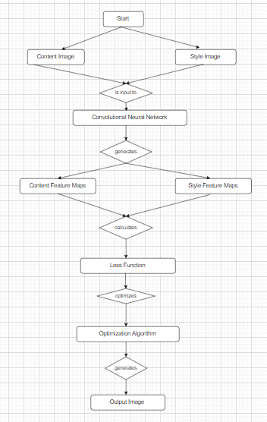
Workflow Diagram

Slide 20
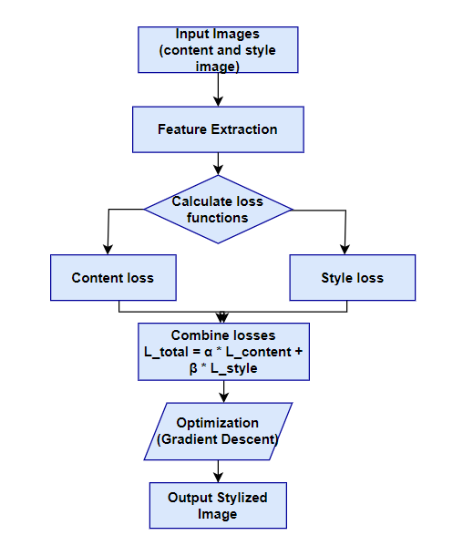
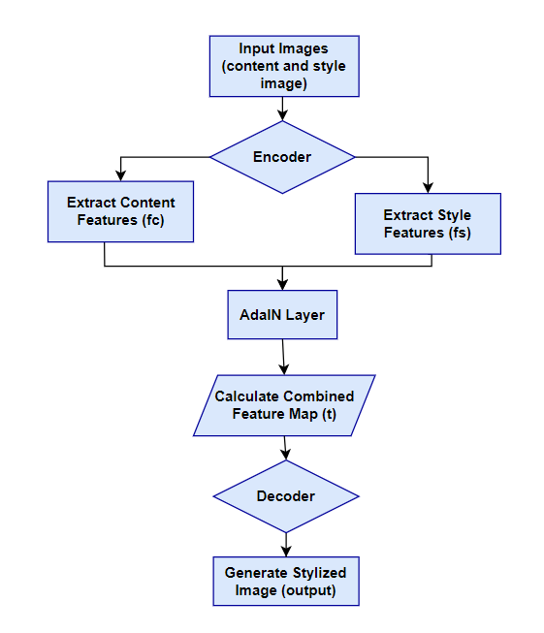
Flow chart of three methods
Gayts method AdaIN method

Slide 21
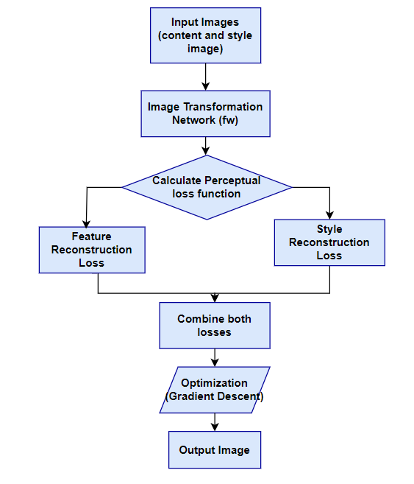
Johnson Method

Slide 22
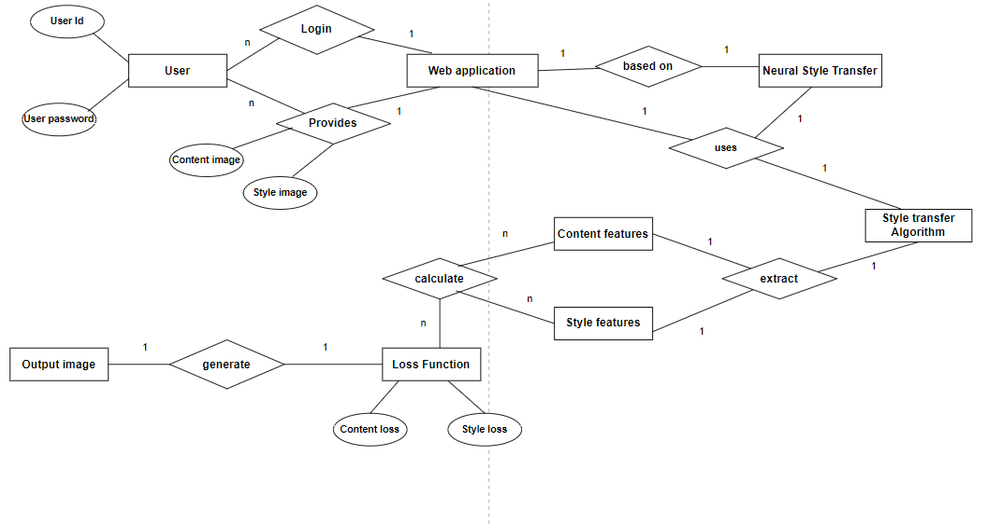
ER Diagram

Slide 23
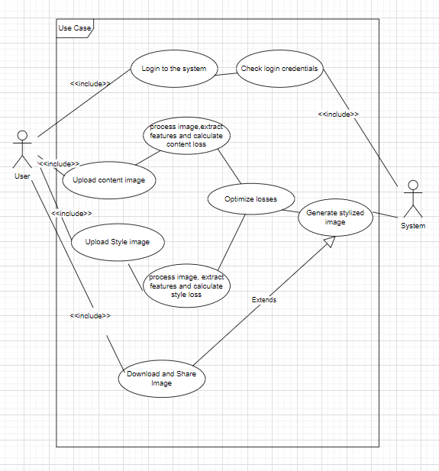
Use case Diagram

Slide 24
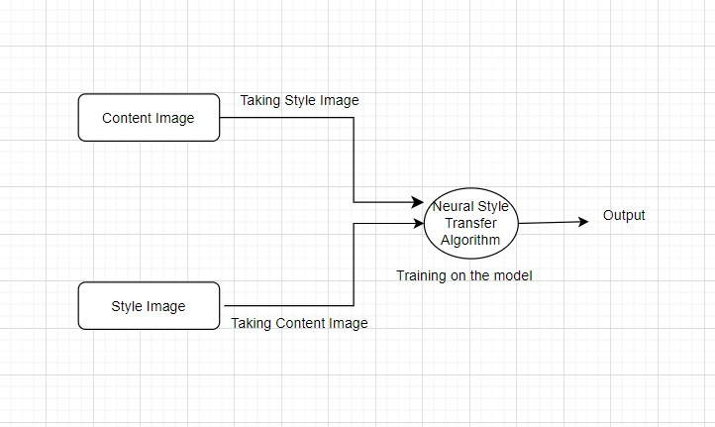
Data Flow Diagram
Level-0 DFD

Slide 25
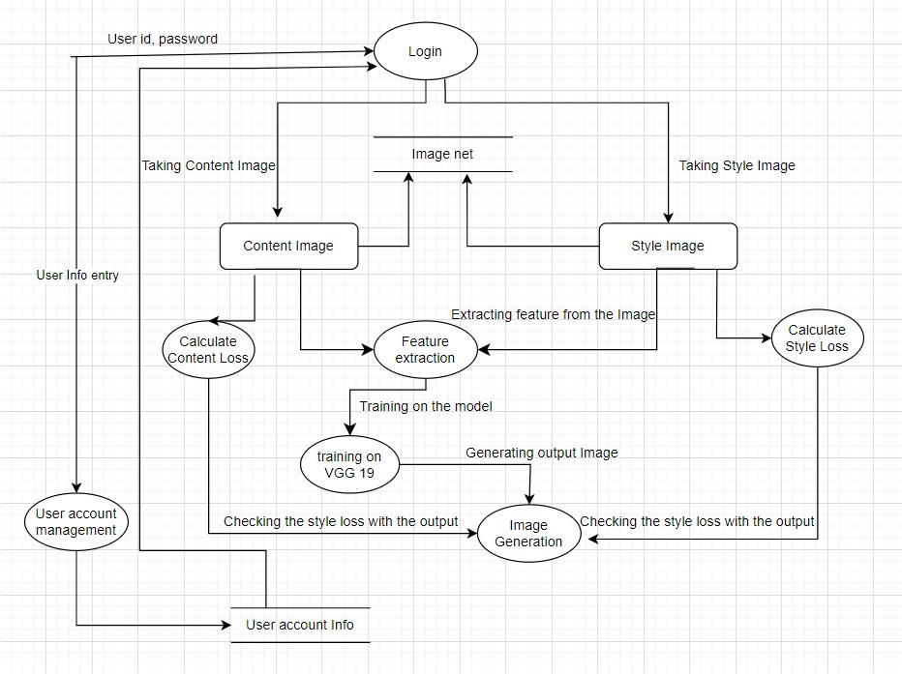
Level-1 DFD

Slide 26
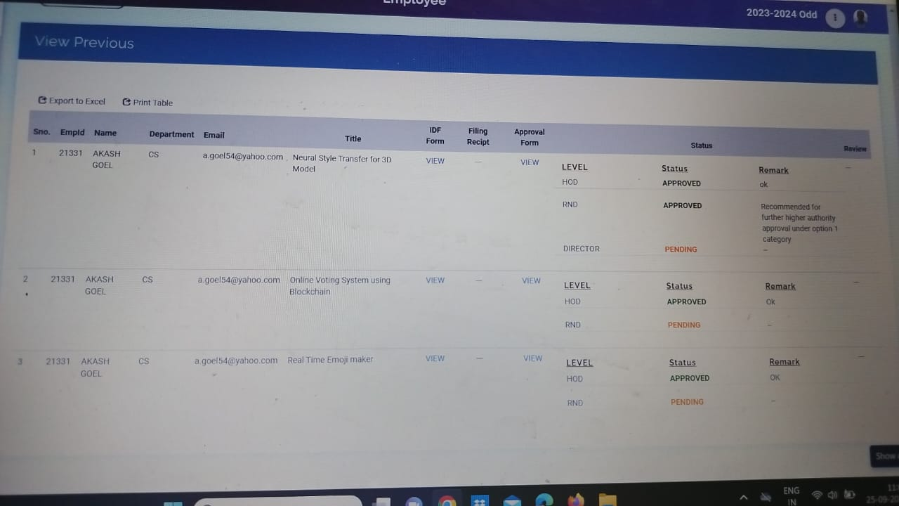
Patent Status

Slide 27
Project Status
90% project completed

Slide 28
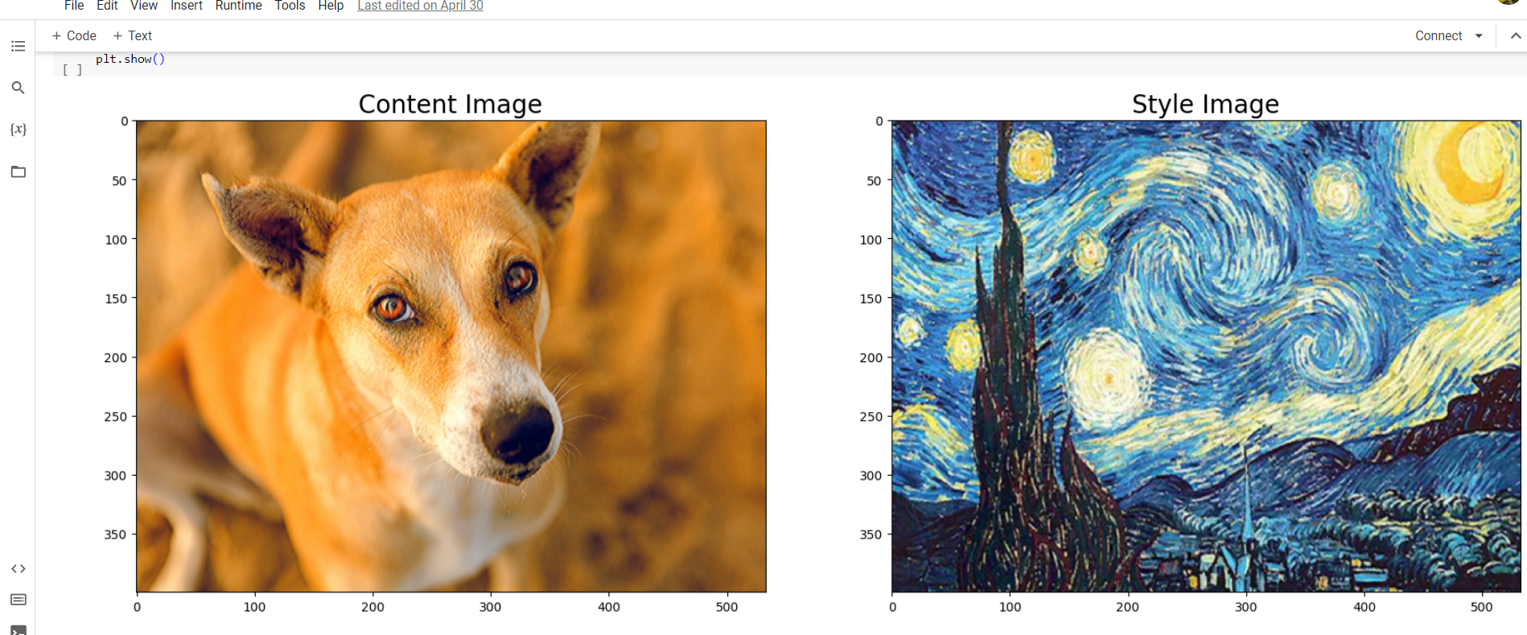

Slide 29
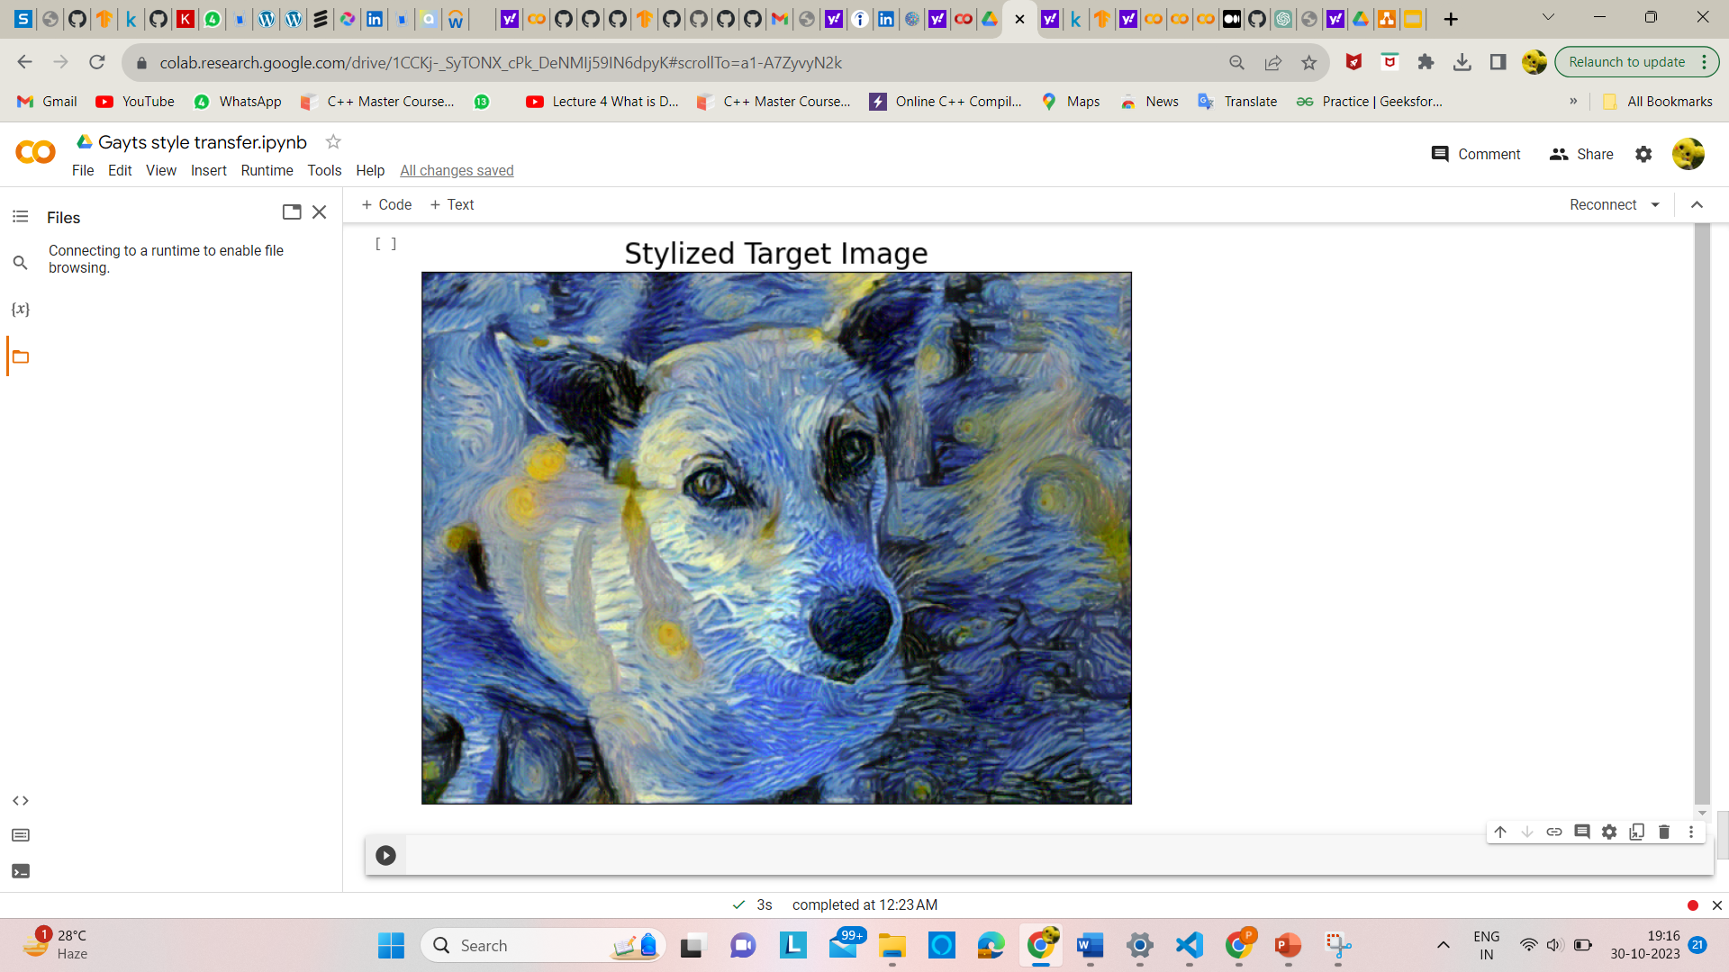
Output Image

Slide 30
Research Paper Status
Research paper completed
Link- https://docs.google.com/document/d/1YHqW2zxltN6VzS4CTK7n4WTQMay8fU_q/edit?usp=sharing&ouid=116324635347389635201&rtpof=true&sd=true

Slide 31
Testing Report
Link- https://docs.google.com/document/d/1O-EMjNVKlLy3lsYnAb6N5CJgWwmvFwgD/edit?usp=sharing&ouid=116324635347389635201&rtpof=true&sd=true

Slide 32
References
John Jethro Virtusio, Jose Jaena Marie Ople, Daniel Stanley Tan,M.Tanveer,Neeraj Kumar,and Kai-Lung Hua, “ Image Neural Style Transfer With Preserving the Salient Regions” IEEE Transactions on multimedia, 2021.
Yijun Liu , Zuoteng Xu , Wujian Ye, Ziwn Zhang , Shaowei Weng , Chin-Chen Chang , and Huajin Tang, “ Image Neural Style Transfer With Preserving the Salient Regions ” Digital Object Identifier, 2019.
Gantugs Atarsaikhan, Brian Kenji Iwana, and Seiichi Uchida, “ Guided neural style transfer for shape stylization”, Department of Advanced Information Technology, Kyushu University, 2021

Slide 33
Ming-Ming Cheng , Xiao-Chang Liu , Jie Wang, Shao-Ping Lu , Yu-Kun Lai , and Paul L. Rosin, “Structure-Preserving Neural Style Transfer, IEEE Transactions on image processing, 2020 .
Leon A. Gatys, Alexander S. Ecker, and Matthias Bethge, “ Image Style Transfer Using Convolutional Neural Networks”, Image Style Transfer Using Convolutional Neural Networks, 2016.
Qibin Hou, Ming-Ming Cheng, Xiaowei Hu, Ali Borji, Zhuowen Tu, Philip H. S. Torr, “ Deeply Supervised Salient Object Detection with Short Connections”, IEEE Transactions on pattern analysis and machine intelligence, 2018.

